Slide 1
Learning in the Garden
How can gardens energize higher-level learning and integrate diverse curricula standards?

Slide 2
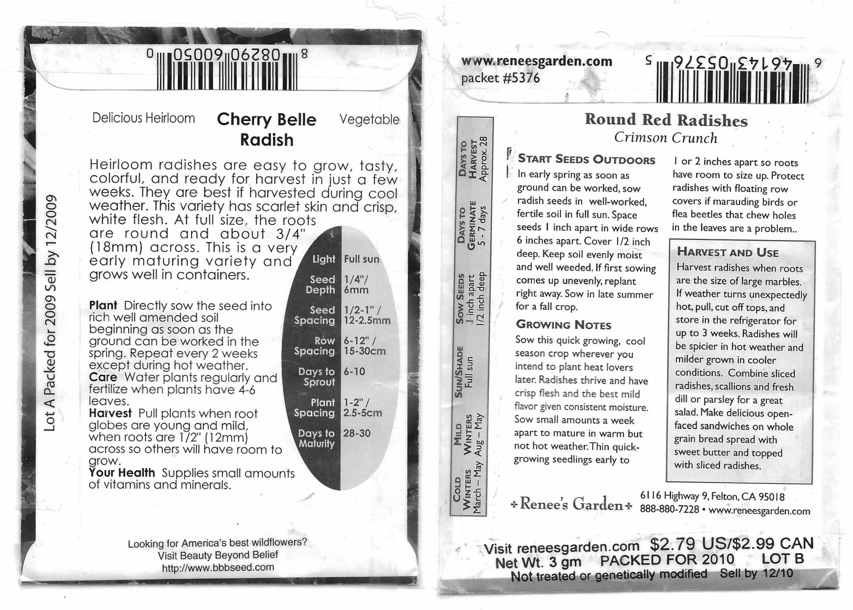
Seeds – Radish Math and Much, Much More

Slide 3
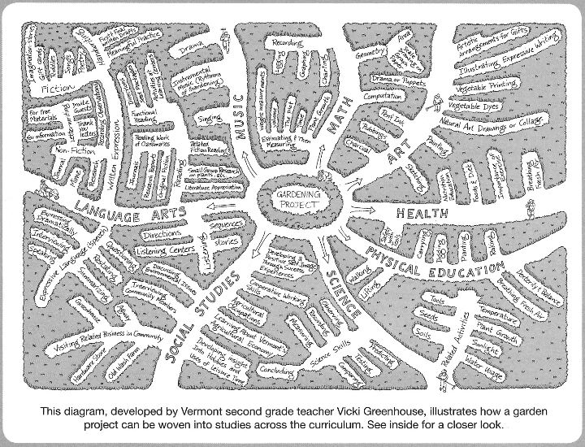

Slide 4
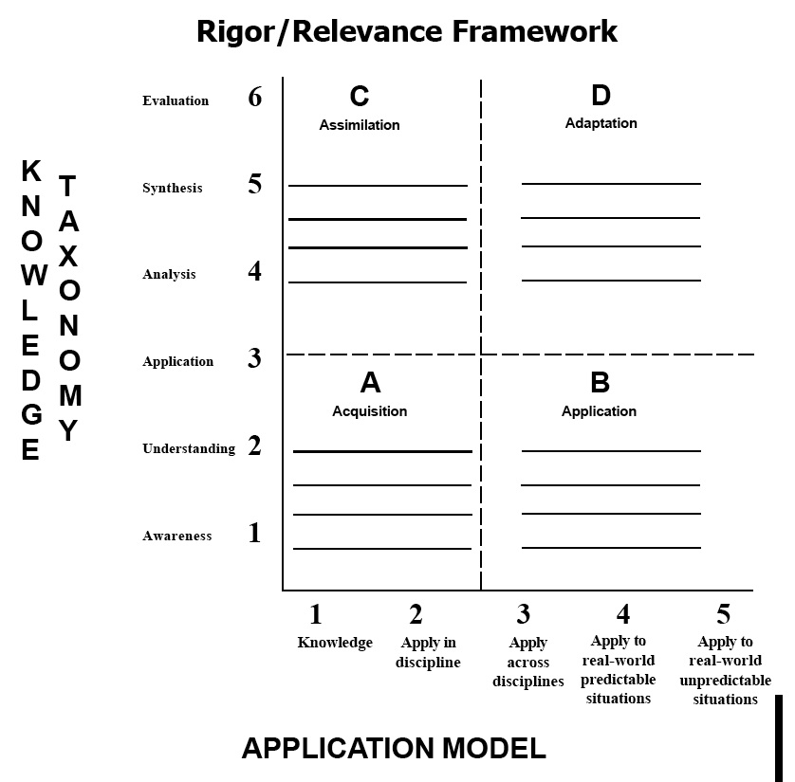
What Works Best?
Source: International Center for Leadership in Education

Slide 5
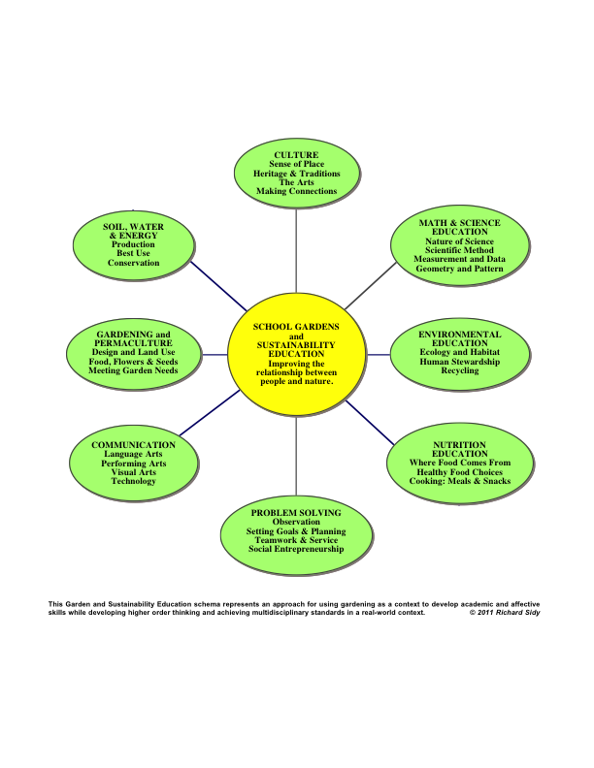

Slide 6
Sense of Place – connecting to geography, traditions, and environment
Planting Your Garden
Elevation
Seasons/climate/weather
Water
Soil
Native & Cultivated plants
Seeds

Slide 7
Elevation & Seasons/climate/weather
When and What to Plant
Resources:
U of A Master Gardeners planting calendar
http://ag.arizona.edu/pubs/garden/mg/vegetable/regions46.html#4-6
Skyview School – Terrain & Elevation Map
https://goo.gl/maps/t1XBzcyxBBz

Slide 8
Water & Soil
Rainfall
http://average-rainfall.weatherdb.com/d/d/Arizona
Rainwater harvesting (.6 gal/sq. ft. for 1” of rain)
http://www.harvestingrainwater.com/
Elementary School Curriculum
http://flagstaffschoolgardens.wordpress.com/curriculum/elementary-curriculum/

Slide 9
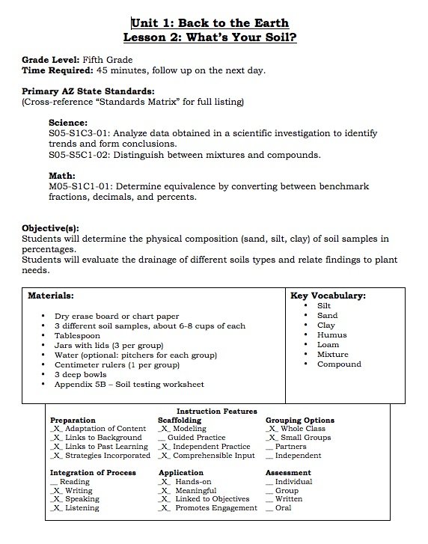
Example of Soil lesson plan – page 1 of 5 (Flagstaff Foodlink)

Slide 10
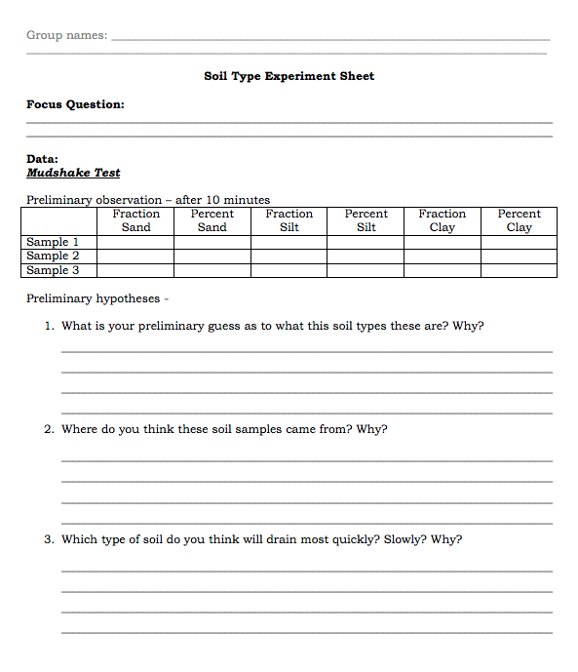
Soil lesson experiment lab report sheet – page 1 of 3 (Flagstaff Foodlink)

Slide 11
Native Plants & Local Agriculture
Desert Harvesters
http://www.desertharvesters.org/native-plant-food-guides-the-desert-can-feed-you/
Native peoples and Settlers
http://www.sedonacentralreservations.com/pages/sedona-history.aspx

Slide 12
Seeds and Seed Saving
Native Seed Search
https://www.nativeseeds.org/
Rocky Mountain Seed Alliance
https://rockymountainseeds.org/
Richmond Grows Seed Lending Library
Resources for seed saving
http://www.richmondgrowsseeds.org/seed-saving.html

Slide 13
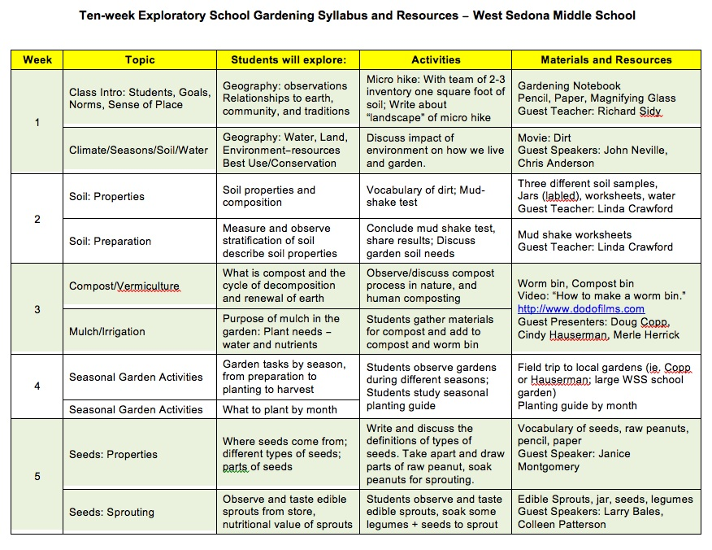
Pulling it all Together

Slide 14
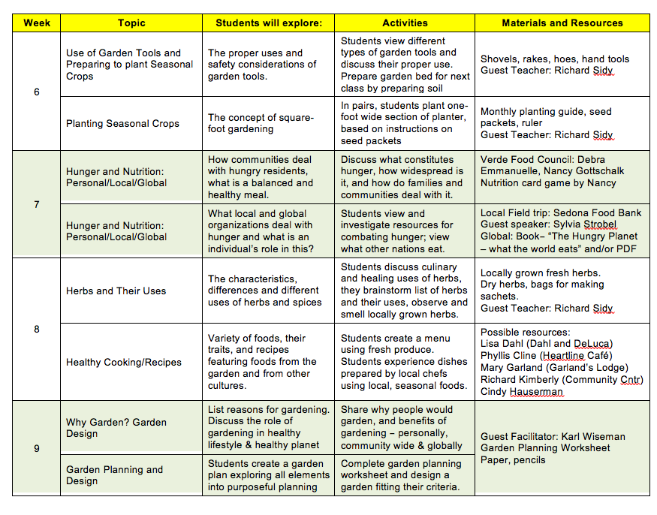

Slide 15

Resources for Learning in School Gardens
http://gardensforhumanity.org/intro-schoolgardens/
Visit our website for more resources, to contact us, or join our mailing list:
http://www.gardensforhumanity.org
Email us at schoolgardens@gardensforhumanity.org
or Richard Sidy, President at president@gardensforhumanity.org
© 2015 Richard Sidy

